Slide 1
SYSTOLIC FOOT DETECTION WITH CONVOLUTIONAL NEURAL NETWORK
Project of Michele Terren, Francescoflavio Falcone and Riccardo Brancher

Slide 2
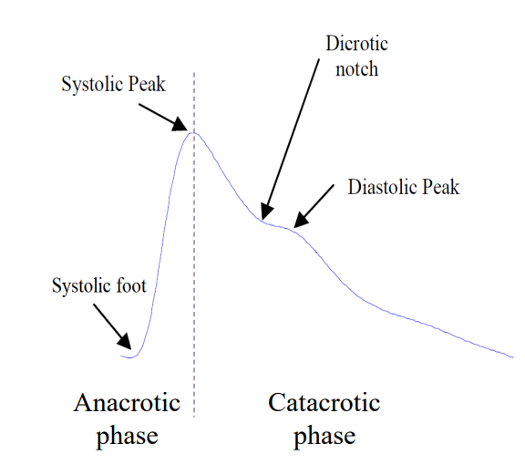
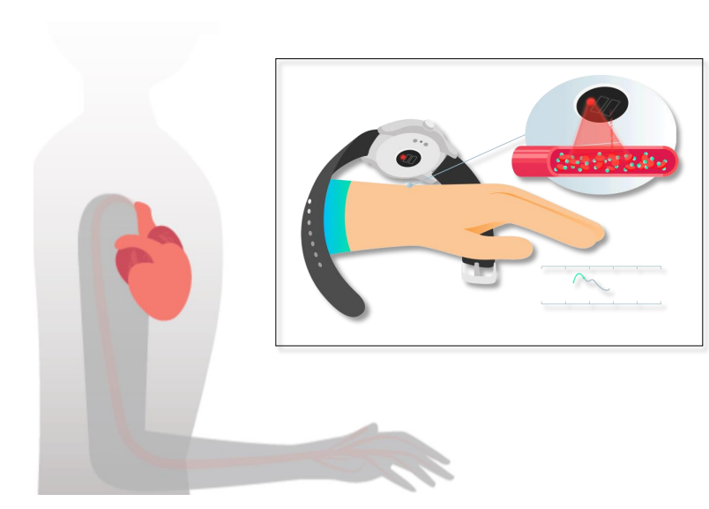
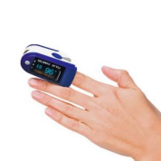
Why a PPG signal?
Photoplethysmography is a technique we can use to have continuous monitoring of cardiac activity. It generates PPG signal.
This technic determines and registers variations in blood volume occurring at each heart beat.
Amplitude of the variation of blood volume is detected using trasducers like air, waters or photodetectors.

Slide 3

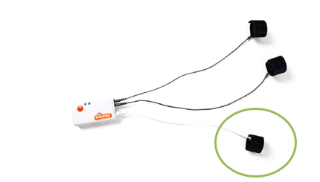
What we have done?
We have developed a Convolutional Neural Network to detect the systolik peak from photopletismographic (PPG) signal. The instruments that we have used are:
Shimmer GSR + unit ( to record PPG signal on fingertip)
Conseys software

Slide 4
Step 1: RECORDING PROCEDURE
Place a PPG sensor correctly on the finger of the subject
Then, we have configurated the sensor through Consensys app.
A rest recording was done, 5 minutes in which the subject had to be as quiet as possible and repeated the procedure for 10 subjects.
In the end we have dowloaded data on our laptop.
Furthermore, to have more data to work with, we downloaded a database of 53 seriously ill patients during hospital care at the Beth Israel Deaconess Medical Center (Boston, MA, USA).

Slide 5
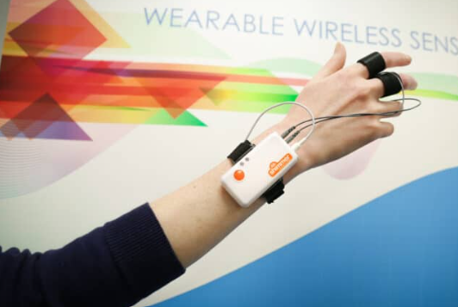
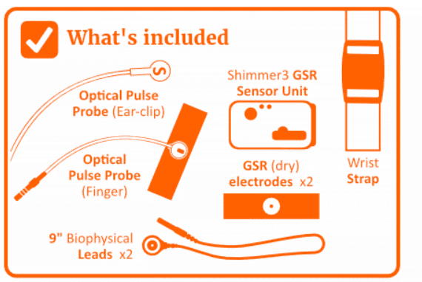
OUR RECORDING:
-> Shimmer3 GSR + unit
-> 1 channel GSR (analogic)
-> Sampling Rate = 128 Hz
-> 1 Channel GSR (Analog)
DATABASE RECORDING:
BIDMC is a subset of MIMIC-II, a larger database that contains data from 2001 to 2008. These signals were recorded through bedside patient monitors.
Sampling Rate = 125 Hz.
https://archive.physionet.org/mimic2/

Slide 6

Step 2: signal processing
We have used a pre-processing procedure as we have done in the laboratory session.
As INPUT we have put the signal we recorded before,voltage [mV].
As OUTPUT we have obtained the signal filtered, the sistolic peaks and the locations of these peaks.
function [PPG_final, peaks, locs, labels, category] = processing_function(PPG, Fs, sample_start, min, plots)
The use of categorical is essential for neural network configuration and classification management. This choice is related to the fact that the neural network must receive data in a specific form for multiclass classification.

Slide 7
Certainly. In the provided MATLAB code, the use of `categorical` is essential for configuring the neural network and managing the multiclass classification. This choice is tied to the fact that the neural network needs to receive data in a specific format for multiclass classification.
1. `categorical` for class labels:
- Class labels ('PEAK' and 'no_peak’) are converted to a special format called `categorical`.
-The neural network uses these categorical labels during both training and evaluation.
2. `category` to define the classes:
- The variable `category` is created as a categorical array containing the available classes, namely 'PEAK' and 'no_peak’.
- This array is used during the definition of the neural network's classification layer to specify the possible classes. Defining `category` is crucial as it informs the network about the classes it should consider during the classification phase.

Slide 8
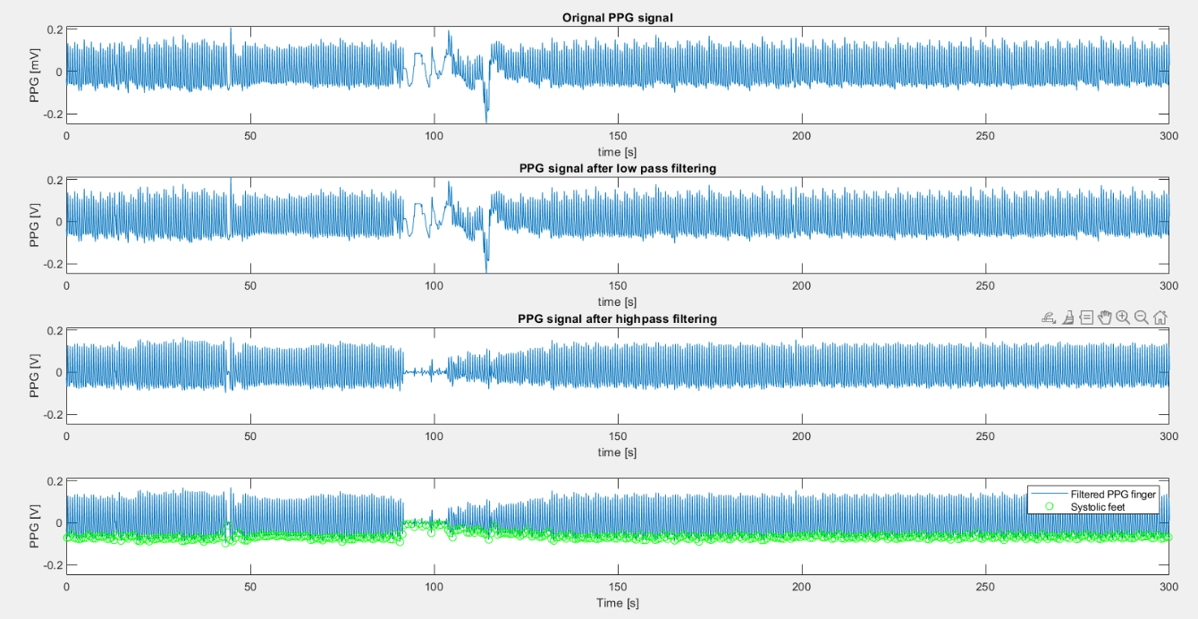
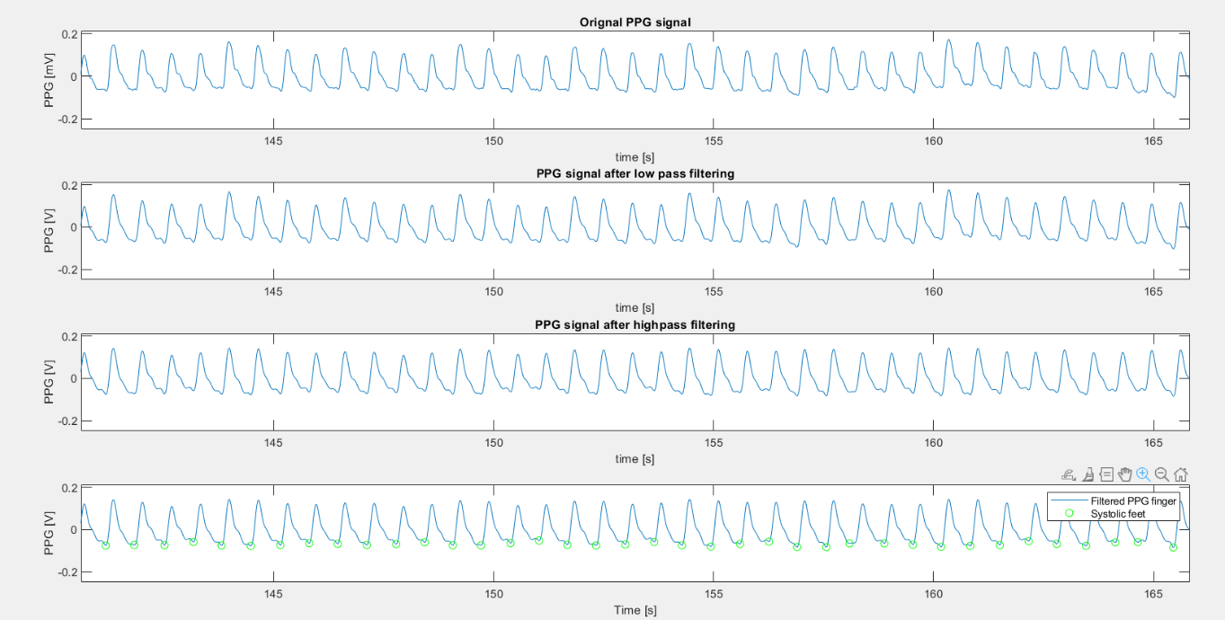
We can see graphically our output on the left about our recordings and on the right about database recordings:
DATASET RECORDING:

Slide 9
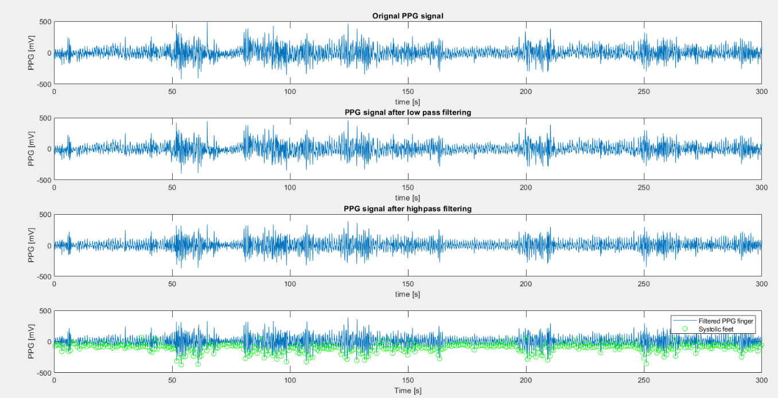
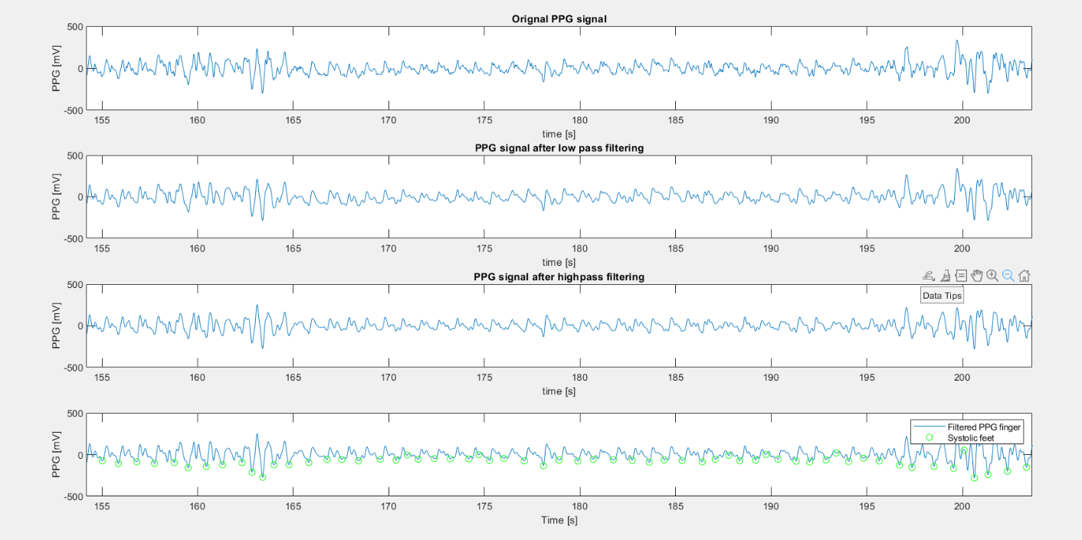
OUR RECORDING DURING LABORATORY LESSONS:

Slide 10
4. CNN: description and analysis
Next came the phase of developing the neural network to detect systolic feet from the previously processed signals.
In this project, a convolutional network was used for classification of one-dimensional PPG signals.
Data were divided into training, validation and test sets.
The basic structure of a CNN consists of an input layer, followed by convolution layers with ReLU activation function, a fully connected layer and an output layer with softmax activation for multiclass classification.

Slide 11
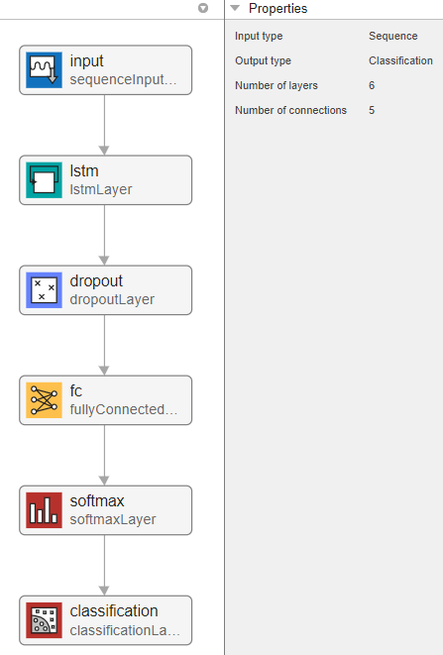
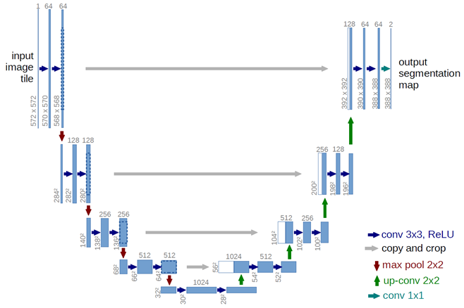
In particular, we started from an example of a multiclass classifier in the MATLAB documentation. Then, starting from the network skeleton, we developed a structure based on our requirements.
On the advice of the tutor, starting from the architecture of the U-NET network for image classification, we recreated a network for the classification of one-dimensional data that mirrors its structure.
ACCURACY | PRECISION | SENSITIVITY | SPECIFICITY | f1SCORE
0.85262 | 0.4221 | 0.84141 | 0.85404 | 0.56218
TCN
ACCURACY | PRECISION | SENTIVITY | SPECIFICITY | f1SCORE
0.96488 | 0.7885 | 0.97787 | 0.96305 | 0.87304
CNN
BETTER!

Slide 12
Training options
The network initially gave us too many false negatives by having unbalanced classes. So to solve the problem, we played with the variable CLASSWEIGHT.
Instead, to improve network performance, we worked on other variables such as: - INITIALEARNRATE
- NUMFILTERS
- DROPFACTOR
- NUMEPOCHS
- MINIBATCH

Slide 13
5. discussion
Next, we analysed the results of the best performing network. It was tested in different situations to see how it performed.
DIFFERENT SIZES OF TRAINING AND TEST SETS:
We try to change this aspect, to see what happened for both nets.
Firstly, we try with this data partitions: 70% = train, 15% = validation, 15% = test
Net trained and validated on the BIDMC dataset partitions (Train, Validation). Tested on the Train partition of BIDMC
ACCURACY | PRECISION | SENSITIVITY | SPECIFICITY | f1SCORE
0.88573 | 0.50203 | 0.9039 | 0.88337 | 0.64553
0.96219 | 0.75767 | 0.98125 | 0.95974 | 0.85509
TCN
CNN

Slide 14
Net trained and validated on the BIDMC dataset partitions (Train, Validation). Tested on the recorded data
ACCURACY | PRECISION | SENSITIVITY | SPECIFICITY | f1SCORE
0.65207 | 0.20583 | 0.84021 | 0.63063 | 0.33066
0.91454 | 0.5525 | 0.86552 | 0.92012 | 0.67446
TCN
CNN
Net trained, validated and tested on the BIDMC dataset partitions (Train, Validation, Test)
ACCURACY | PRECISION | SENSITIVITY | SPECIFICITY | f1SCORE
0.85262 | 0.4221 | 0.84141 | 0.85404 | 0.56218
0.96488 | 0.7885 | 0.97787 | 0.96395 | 0.87304
TCN
- Then, we try with this data partitions: 40% = train, 30% = validation, 30% = test
Net trained, validated and tested on the BIDMC dataset partitions (Train, Validation, Test)
ACCURACY | PRECISION | SENSITIVITY | SPECIFICITY | f1SCORE
0.86662 | 0.45551 | 0.85181 | 0.86853 | 0.5936
0.9588 | 0.75106 | 0.95649 | 0.9591 | 0.84142
TCN
CNN

Slide 15
Net trained and validated on the BIDMC dataset partitions (Train, Validation). Tested on the Train partition of BIDMC
ACCURACY | PRECISION | SENSITIVITY | SPECIFICITY | f1SCORE
0.92076 | 0.61321 | 0.88077 | 0.92608 | 0.72303
0.96192 | 0.75888 | 0.98686 | 0.95863 | 0.85798
TCN
CNN
Net trained and validated on the BIDMC dataset partitions (Train, Validation). Tested on the recorded data
ACCURACY | PRECISION | SENSITIVITY | SPECIFICITY | f1SCORE
0.75153 | 0.20275 | 0.48741 | 0.78162 | 0.28637
0.9241 | 0.58906 | 0.85293 | 0.9322 | 0.69686
TCN
CNN
After analysing these different approaches, we came to the conclusion that the second network implemented is the most efficient. We continued the analysis by focusing on the results obtained by the latter.

Slide 16
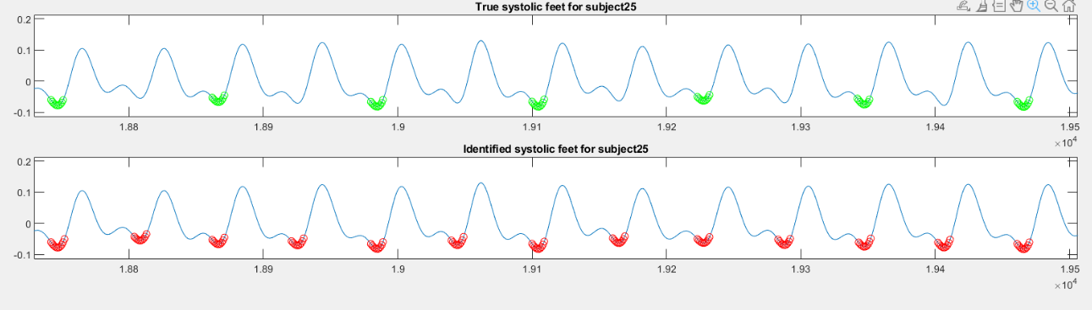
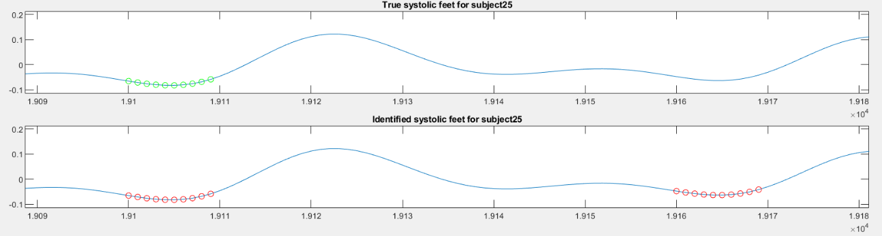
ANALYSIS WITH GOOD OR NOT RECORDINGS:
So, the task was to independently detect the systolic peak in a PPG signal given as input. It can be seen that the last plot has red dots representing the systolic peak found by the network.
Why do multiple dots highlight only one peak?
Through numerous attempts we realized that by imposing a circle of dots as the peak and not the single one, we had a better learning of the network.

Slide 17
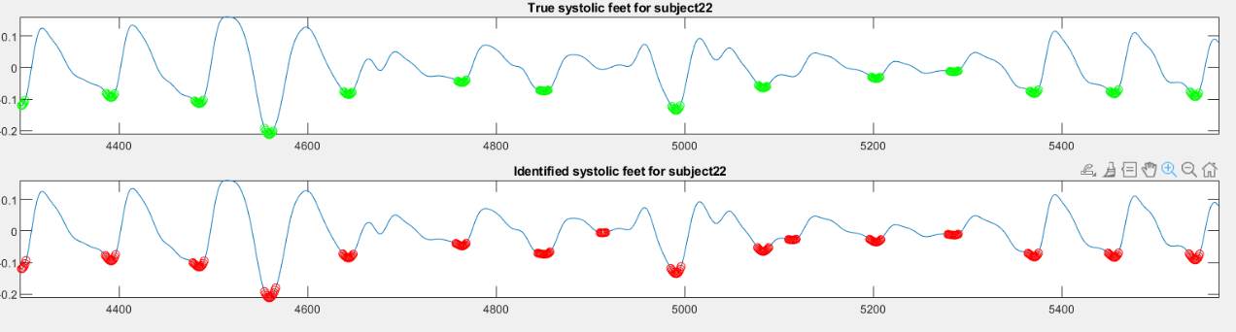
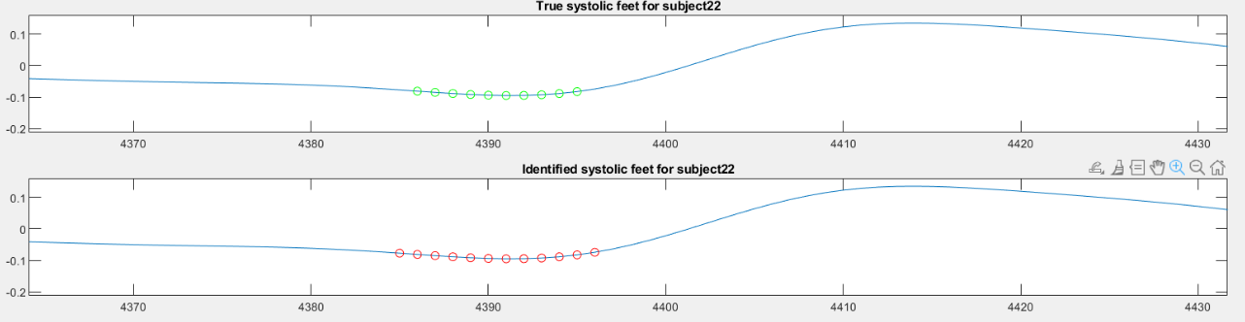
In addition, the network was also trained using recordings that presented noise. In the image below, it can be observed how it behaved.
We can observe that even in the absence of noise, the net tends to find more points in the neighbourhood of the systolic foot compared to those found with findpeaks.

Slide 18
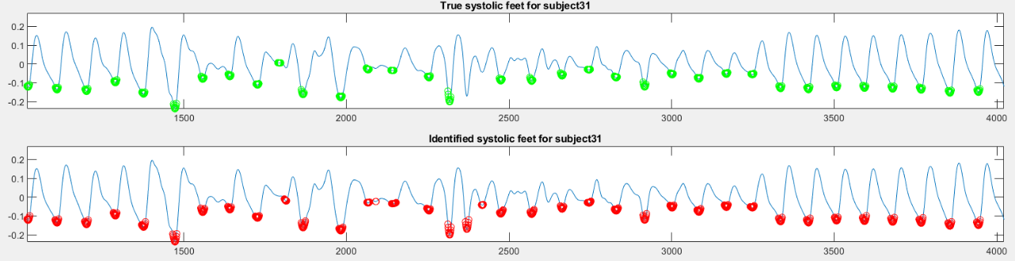
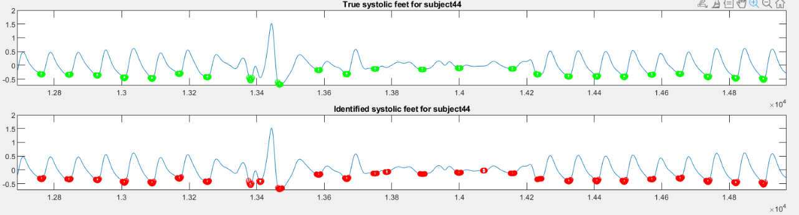
Another examples of non-ideal recordings:

Slide 19

DOES IT MAKES SENSE TO USE SUCH A NETWORK FOR SYSTOLIC FEET DETECTION IF THERE IS A FINDPEAKS FUNCTION THAT DOES THE SAME THING?

